Slide 1
Strategic Importance of Employee Well Being

Slide 2

Mental Health

Slide 3
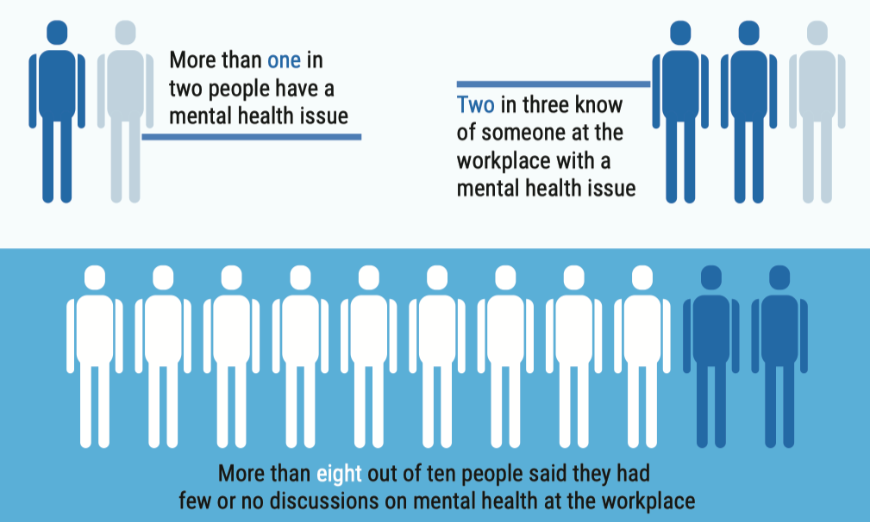
Source: White Swan Foundation
Notes:
“Workplace Mental Health” A survey-based report by White Swan Foundation / 2019 – 829 Participants

Slide 4
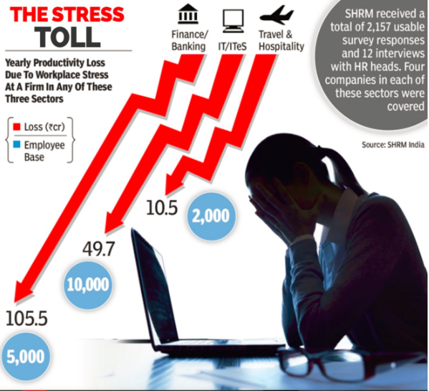


Impact of stress at workplace
Could be a very costly problem for the organization!
  Lower Engagement
  Lesser Productivity
  Higher Absenteeism
  Increased Presentism
  Increase Insurance cost
Notes:
SHRM study in Jul 2016. Published in TOI / 2157 survey responses

Slide 5
How India Perceives Mental Health?
Notes:
This study was conducted by The Live Love Laugh Foundation
The study took place across eight cities in India over a span of 5 five months and involved 3,556 respondents.
A representation was maintained across various age-bands (within 18 to 45 years) and socioeconomic classes so as to cover the knowledge, attitude and behaviour of people across the different economic stratas, and various stages of life.

Slide 6
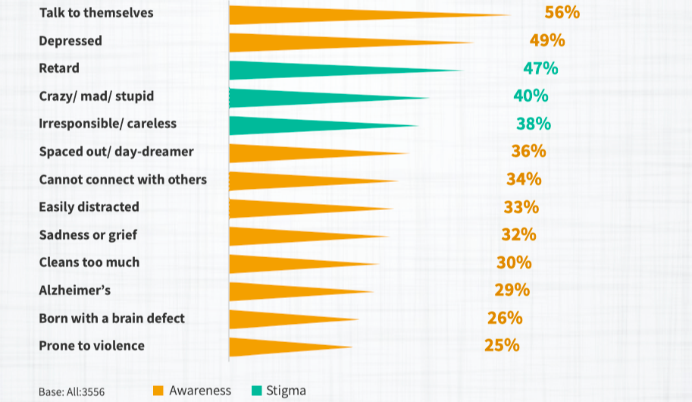
How would you describe a person with mental health issue?
Source: Live Laugh Love Foundation
Notes:
To capture the response on how the participants would identify a person with mental illness, they were asked ;How would you describe a mentally ill person? The respondents were not prompted with any clues related to clinical terms for mental illnesses.

Slide 7
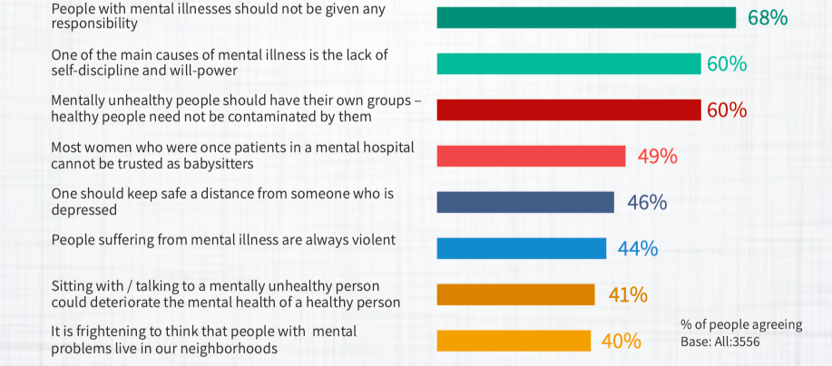
Attitude towards Mental Health
Source: Live Laugh Love Foundation

Slide 8
The Covid Impact
Notes:
This study was conducted by The Live Love Laugh Foundation
The study took place across eight cities in India over a span of 5 five months and involved 3,556 respondents.
A representation was maintained across various age-bands (within 18 to 45 years) and socioeconomic classes so as to cover the knowledge, attitude and behaviour of people across the different economic stratas, and various stages of life.

Slide 9

Socio – Economical Impact ​
41 lakhs jobs lost in India during pandemic​.
Unemployment rate continues to be high
Households that experienced a fall in income shot up to nearly 46 percent
Inflation rates on goods and services including food products and fuel were expected to rise
Social Distancing led to job losses in the lower strata
Terminated household chores. Do it themselves

Slide 10
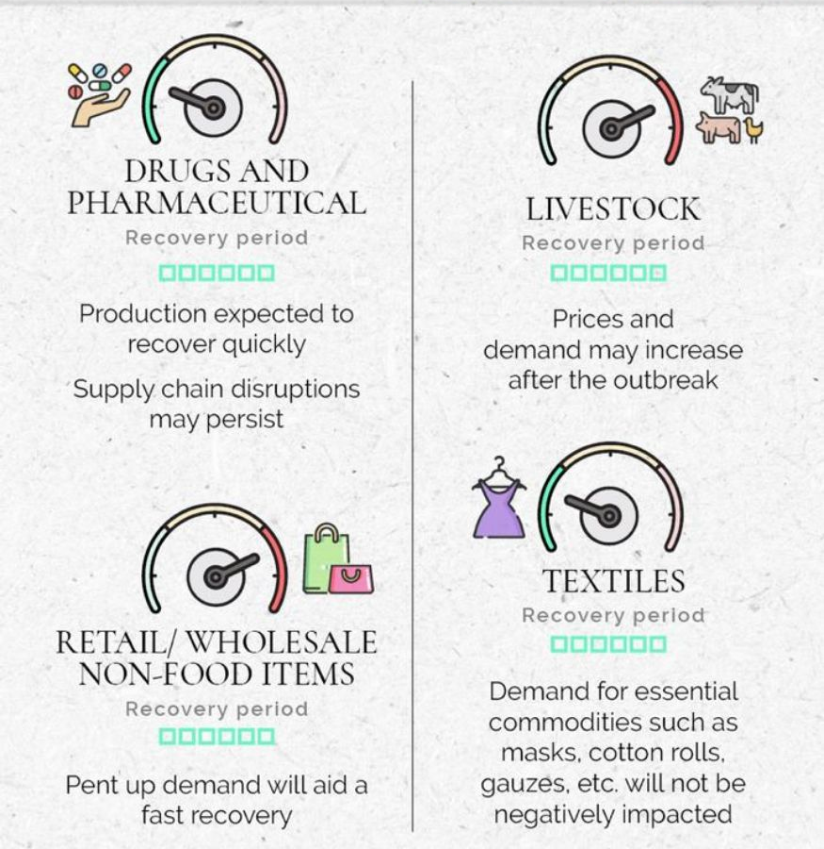
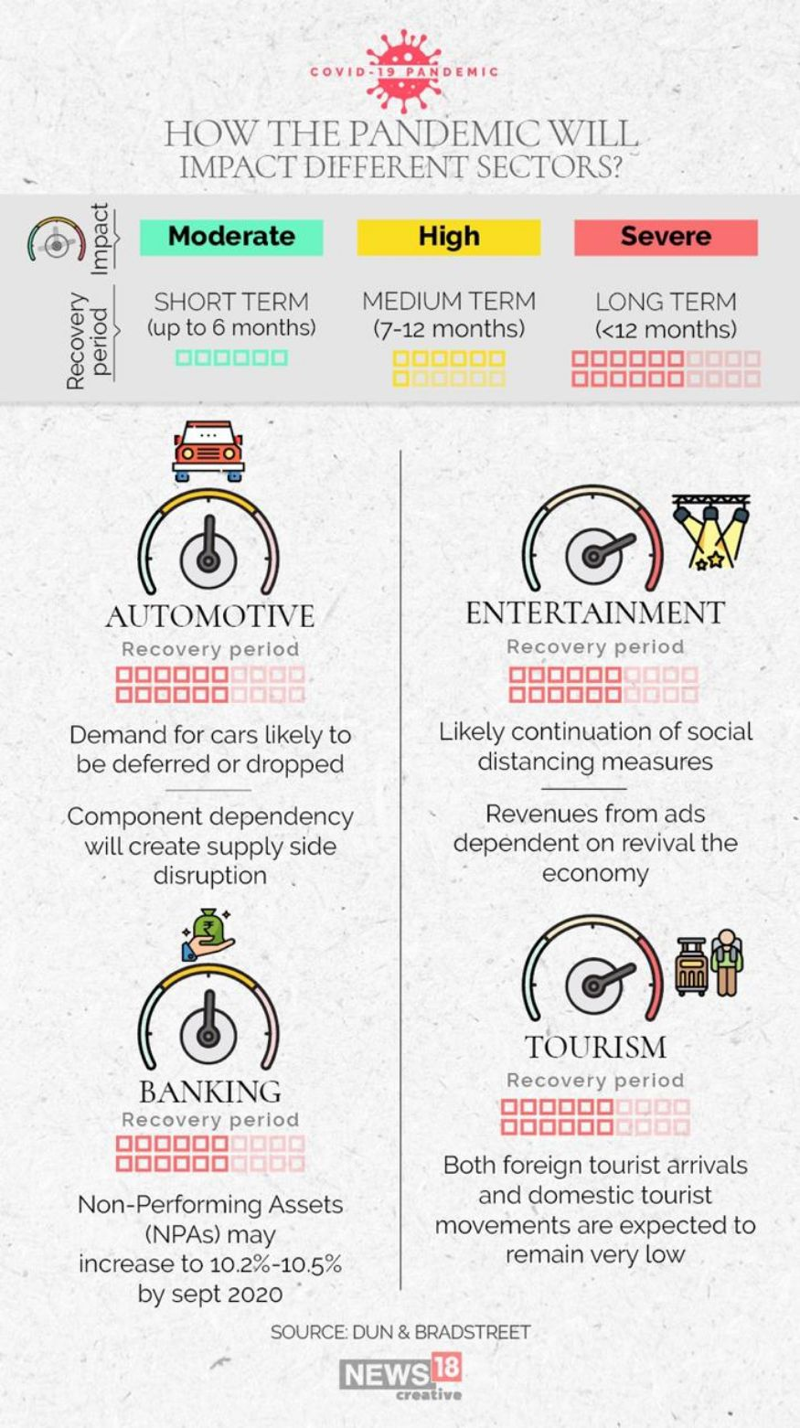
Impact of Covid on Industries !!!

Slide 11
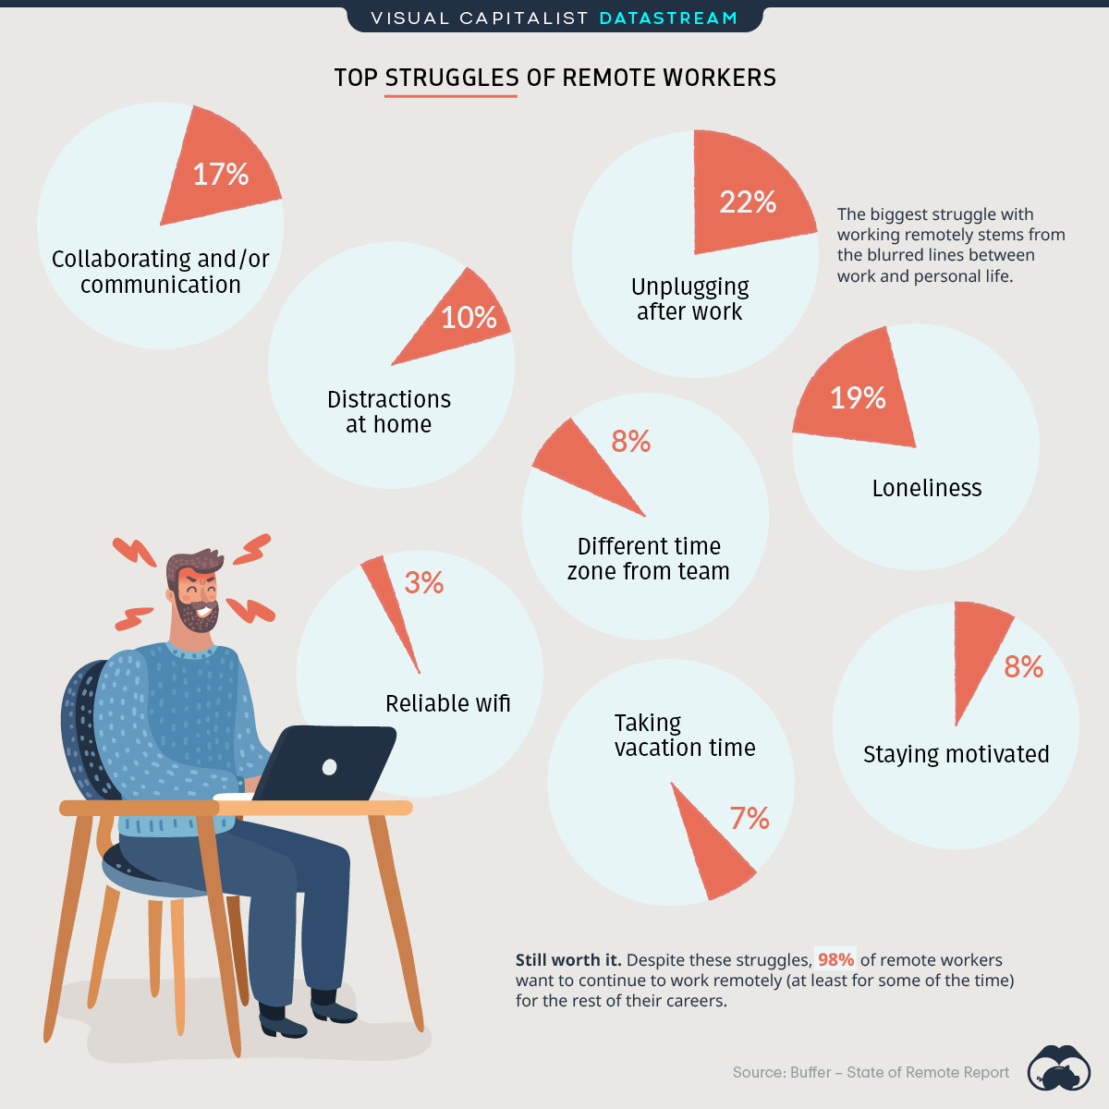
Impact of Pandemic on individuals!!!
37% increase in Stress-Related Absence at work since last year (Absenteeism)
89% of Employees said that they have worked while feeling unwell (presenteeism)

Slide 12
How can you become more aware of workplace stress?

Slide 13
Symptoms of Stress
Fatigue, Muscular tension
Headaches, Heart Palpitations
Sleeping problems (insomnia)
Stomach upset, Menstrual cycle disruption
Depression & Anxiety
Stress, Pessimism
Feelings of overwhelmed
Physical effects
Psychological effects
Behavioural effects
Loss of interest in activities
Aggression / Anger / Irritability
Interpersonal challenges
Social withdrawal
Cognitive effects
Reduced ability to focus
Poor concentration
Unable to make decisions
Disruptions in memory

Slide 14
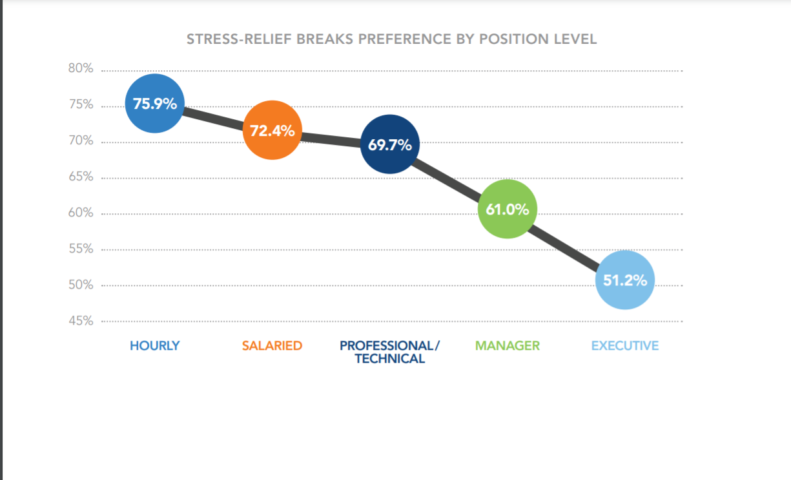
What Employees Want ?

Slide 15
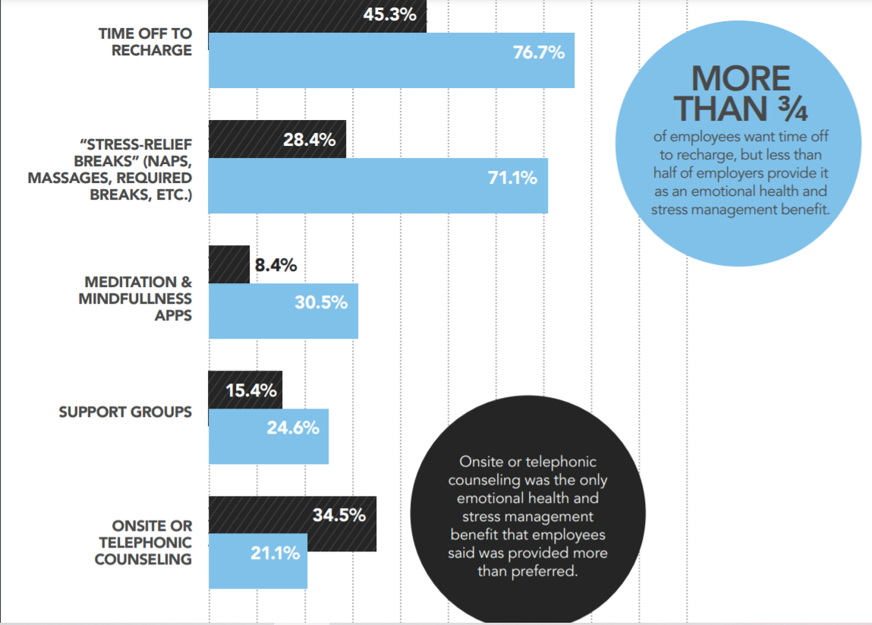
What Employees Want?

Slide 16
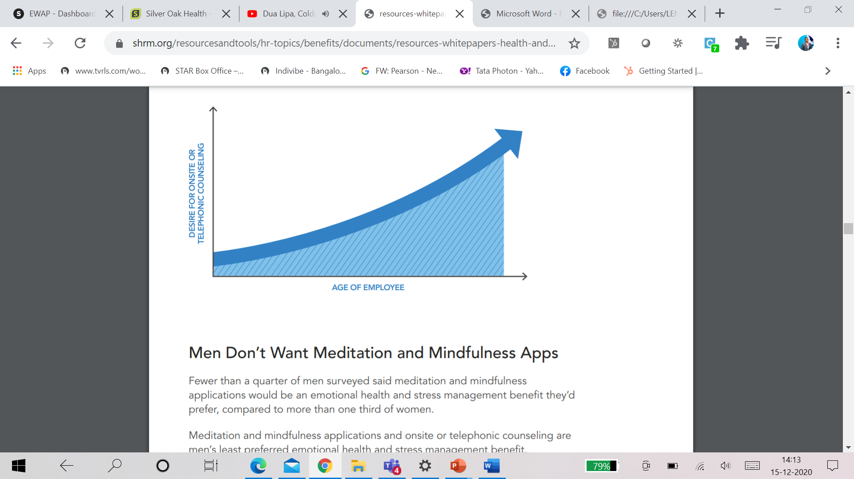
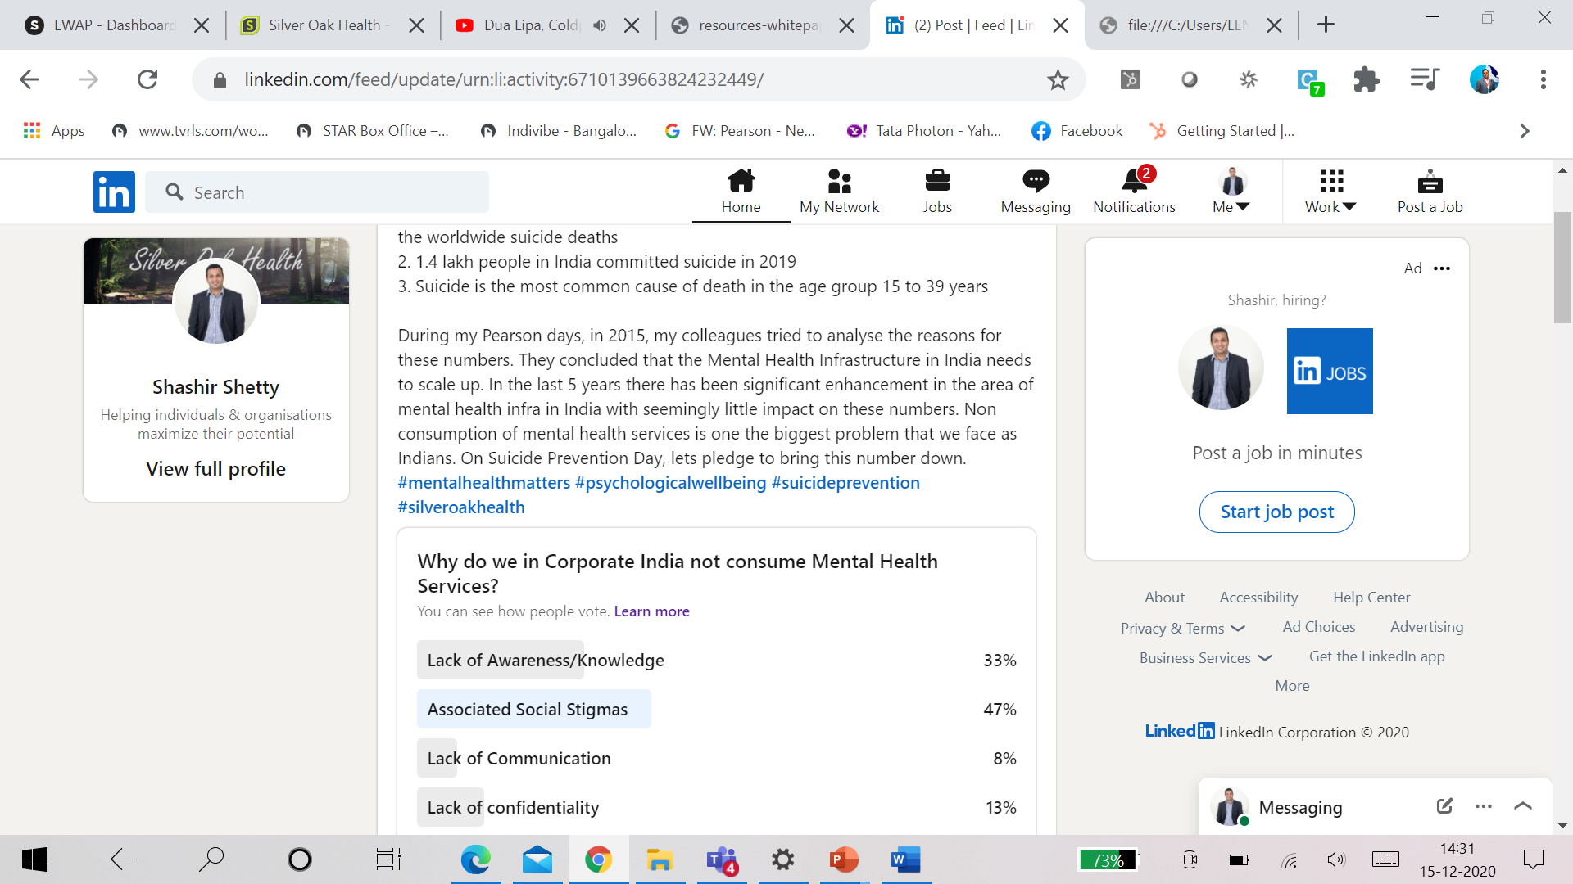
Utilisation & Engagement

Slide 17






What can Organisations do to help?
Everyone copes differently
Recognize the impact of isolation and loneliness
Sensitise managers to Show empathy & be available
Dealing with Anxiety
Disrupted Sleep Patterns
Trust in employees to be productive
Encourage People to ask for help
Encourage Learning & Virtual Breaks
Webinars & Engagement
Mindfulness & Meditation
Cognitive Behavioral Therapy
Counselling &
Sharing

Slide 18
Why Should you Invest?
Top 5 Stress Symptoms for leave
- Constant Fatigue (29%)
- Sleeplessness (26%)
- Aches & Pains (24%)
- High Anxiety (23%)
- Weight Gain (18%)
Job Burnout - 61% of employees are burned out in a job (career builder)
Overall Wellbeing - 61% of employees agree that they have made Lifestyle Choices because Workplace Wellness
Lower Health Costs - 62% of workplace wellness program participants
Job Satisfaction – 70% Employees in workplace wellness programs (Aflac)
Employee Motivation - 91% of workers at companies led by leaders that support wellness say they feel Motivated
Business Performance - Organisations with highly effective wellness programs report
- 11% higher revenue per employee
- 1.8 fewer days absent per employee per year
- 28% greater shareholder value
Great Place to Work Recommendation – 89% of employees

Slide 19
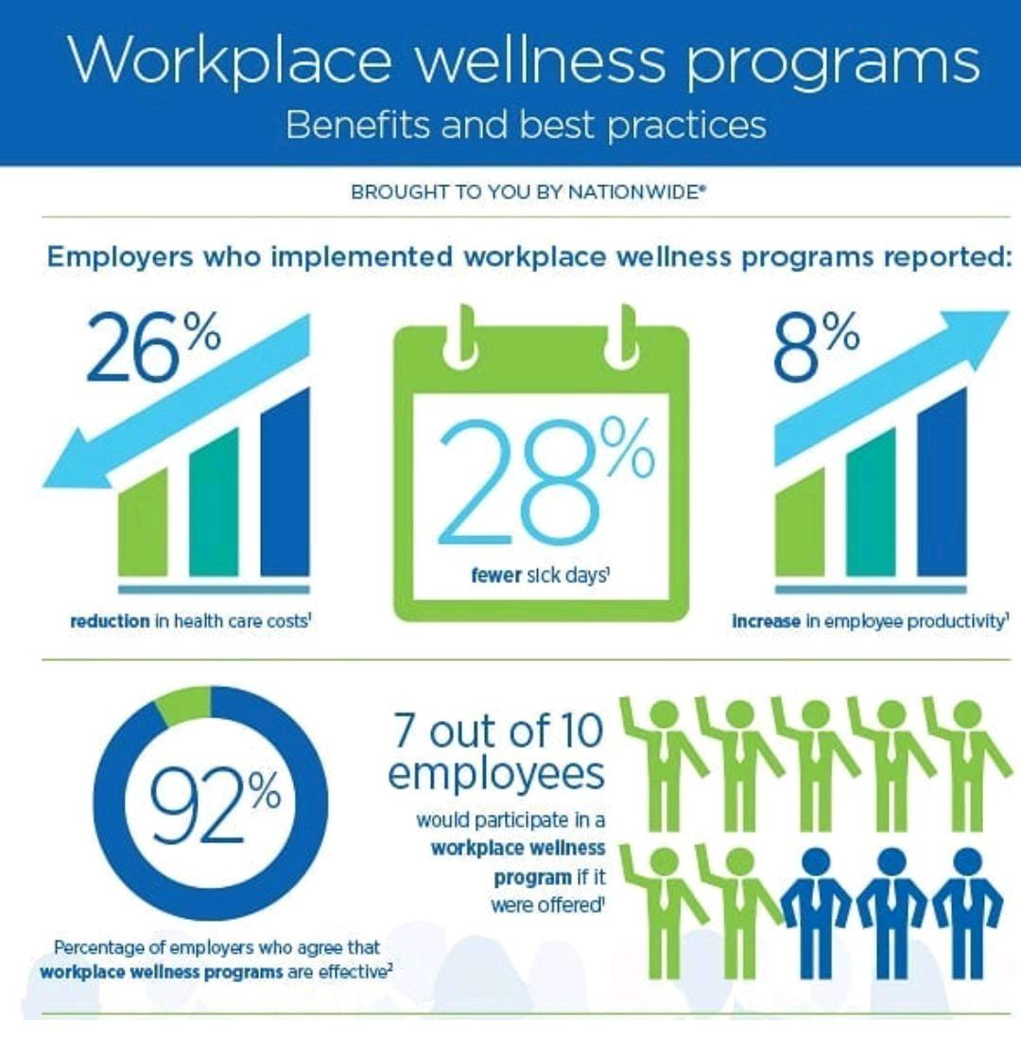

Slide 20
Q&A
Thank You

